Slide 1
Office Computer Application WEEK TEN
Muhammad Unggul Pamenang

Slide 2
Please Do It With MS Excel from 2010 - 2016

Slide 3
Formatting Cells
4
MS Excel 2016

Slide 4
Introduction
All cell content uses the same formatting by default, which can make it difficult to read a workbook with a lot of information. Basic formatting can customize the look and feel of your workbook, allowing you to draw attention to specific sections and making your content easier to view and understand.

Slide 5
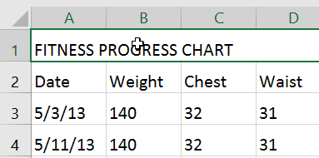
To change the font size:
Select the cell(s) you want to modify.

Slide 6
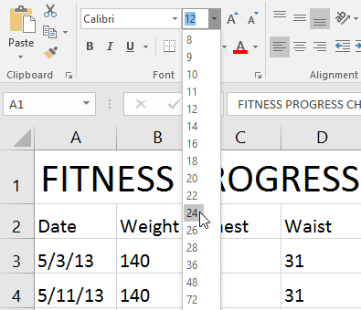
To change the font size:
On the Home tab, click the drop-down arrow next to the Font Size command, then select the desired font size. In our example, we will choose 24 to make the text larger.

Slide 7
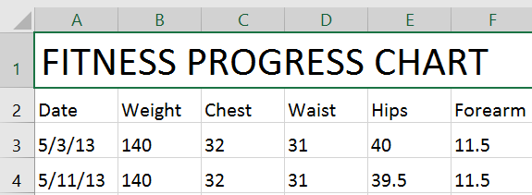
To change the font size:
The text will change to the selected font size.

Slide 8
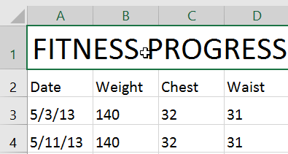
To change the font:
By default, the font of each new workbook is set to Calibri. However, Excel provides many other fonts you can use to customize your cell text. In the example below, we'll format our title cell to help distinguish it from the rest of the worksheet.
Select the cell(s) you want to modify.

Slide 9
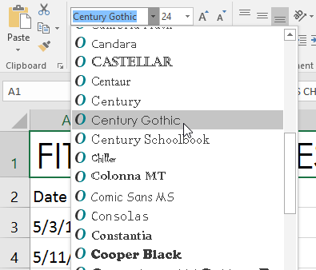
To change the font:
On the Home tab, click the drop-down arrow next to the Font command, then select the desired font. In our example, we'll choose Century Gothic.

Slide 10
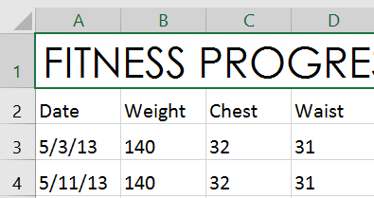
To change the font:
The text will change to the selected font.

Slide 11
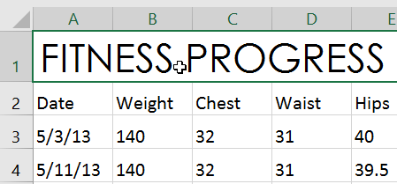
To change the font color:
Select the cell(s) you want to modify.

Slide 12
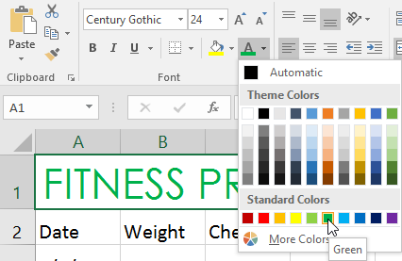
To change the font color:
On the Home tab, click the drop-down arrow next to the Font Color command, then select the desired font color. In our example, we'll choose Green.

Slide 13
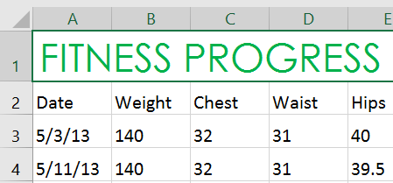
To change the font color:
The text will change to the selected font color.

Slide 14
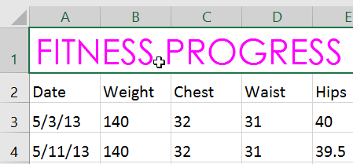
To use the Bold, Italic, and Underline commands:
Select the cell(s) you want to modify.

Slide 15
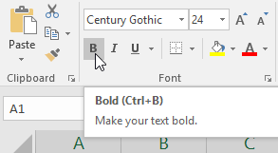
To use the Bold, Italic, and Underline commands:
Click the Bold (B), Italic (I), or Underline (U) command on the Home tab. In our example, we'll make the selected cells bold.

Slide 16
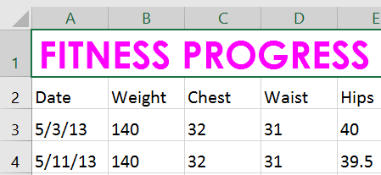
To use the Bold, Italic, and Underline commands:
The selected style will be applied to the text.

Slide 17
Cell borders and fill colors
Cell borders and fill colors allow you to create clear and defined boundaries for different sections of your worksheet. Below, we'll add cell borders and fill color to our header cells to help distinguish them from the rest of the worksheet.

Slide 18
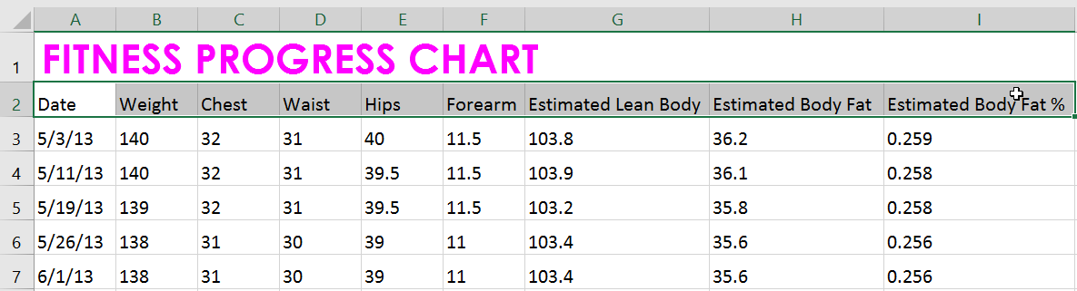
To add a fill color:
Select the cell(s) you want to modify.

Slide 19
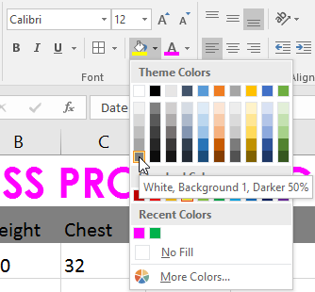
To add a fill color:
On the Home tab, click the drop-down arrow next to the Fill Color command, then select the fill color you want to use. In our example, we'll choose a dark gray.

Slide 20
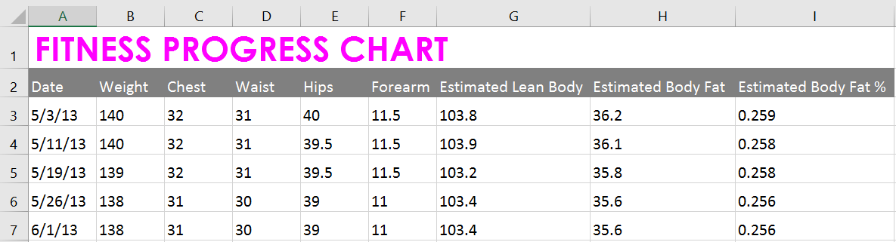
To add a fill color:
The selected fill color will appear in the selected cells. We've also changed the font color to white to make it more readable with this dark fill color.

Slide 21
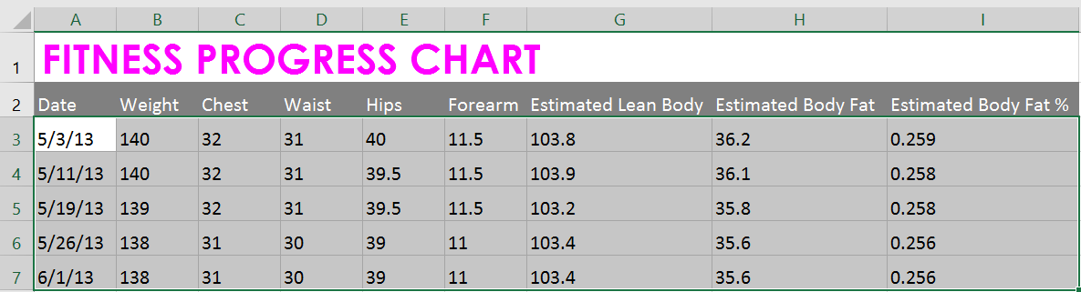
To add a border:
Select the cell(s) you want to modify.

Slide 22
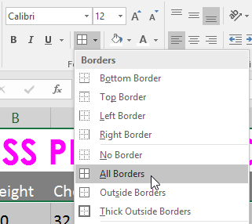
To add a border:
On the Home tab, click the drop-down arrow next to the Borders command, then select the border style you want to use. In our example, we'll choose to display All Borders.

Slide 23
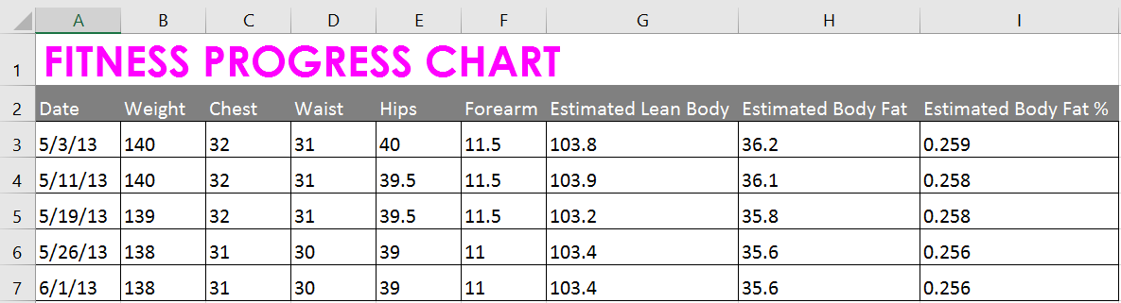
To add a border:
The selected border style will appear.

Slide 24
Cell styles
Instead of formatting cells manually, you can use Excel's predesigned cell styles. Cell styles are a quick way to include professional formatting for different parts of your workbook, such as titles and headers.

Slide 25
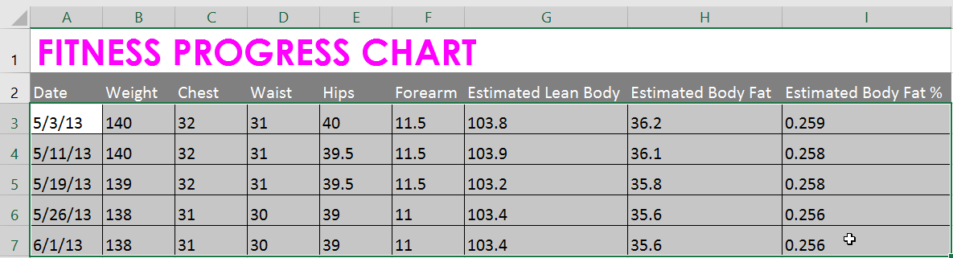
To apply a cell style:
In our example, we'll apply a new cell style to our existing title and header cells.
Select the cell(s) you want to modify.

Slide 26
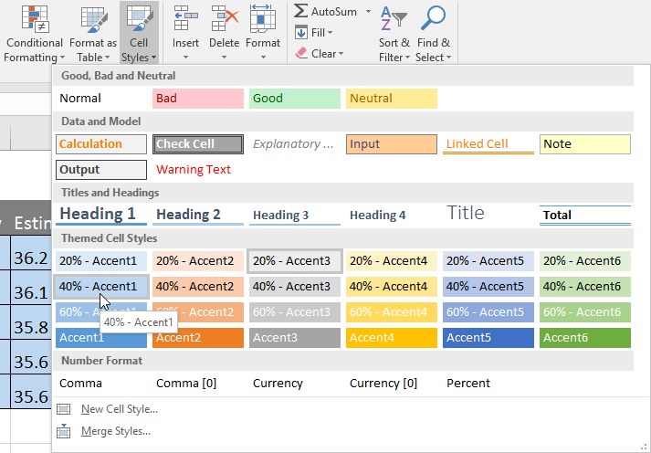
To apply a cell style:
Click the Cell Styles command on the Home tab, then choose the desired style from the drop-down menu.

Slide 27
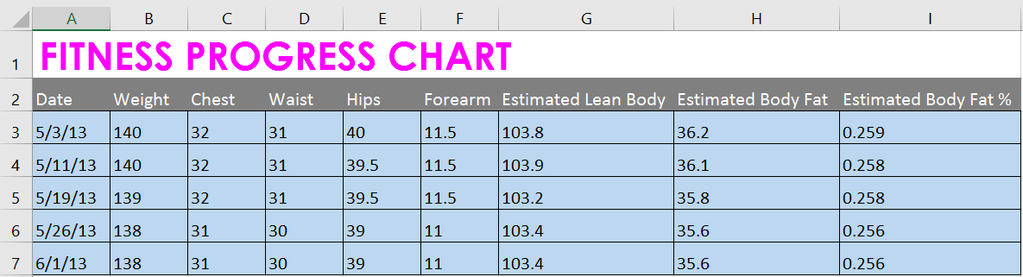
To apply a cell style:
The selected cell style will appear.

Slide 28
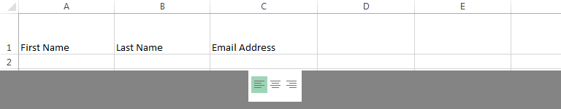
Text alignment
By default, any text entered into your worksheet will be aligned to the bottom-left of a cell, while any numbers will be aligned to the bottom-right. Changing the alignment of your cell content allows you to choose how the content is displayed in any cell, which can make your cell content easier to read.
Left Align: Aligns content to the left border of the cell

Slide 29
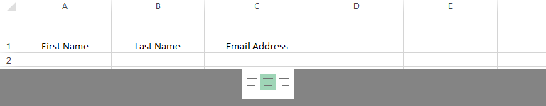
Text alignment
Center Align: Aligns content an equal distance from the left and right borders of the cell

Slide 30
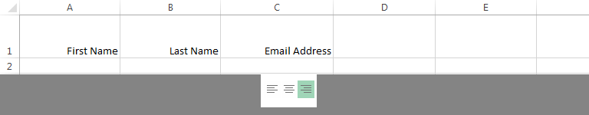
Text alignment
Right Align: Aligns content to the right border of the cell

Slide 31
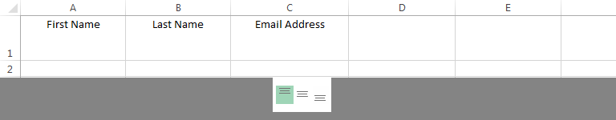
Text alignment
Top Align: Aligns content to the top border of the cell

Slide 32
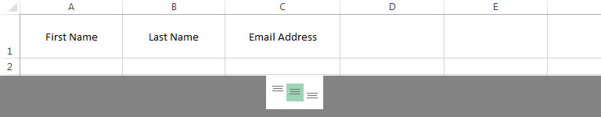
Text alignment
Middle Align: Aligns content an equal distance from the top and bottom borders of the cell

Slide 33
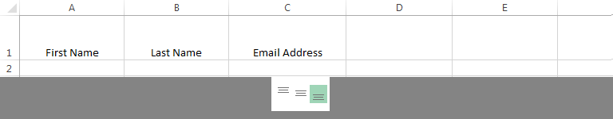
Text alignment
Bottom Align: Aligns content to the bottom border of the cell

Slide 34
JOBSHEET
Continue working

Slide 35
THANKS!

